Slide 1
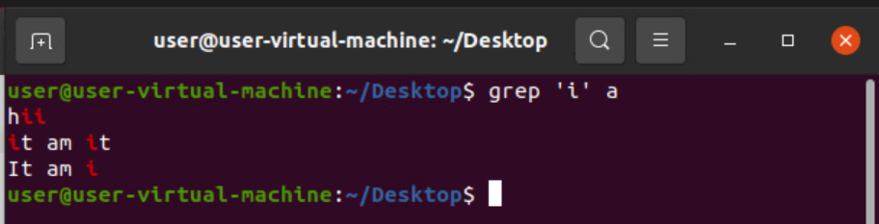
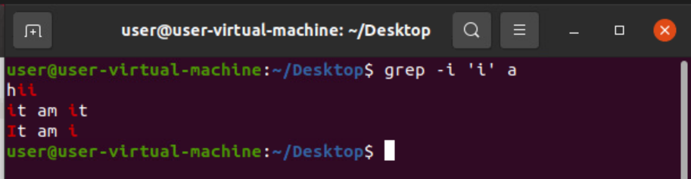
LINUX grep COAMMNDS
1) $grep 'word' filename :- Used to find the string or word with case sensitive (Including substring).
2) $ grep –i'word ' file name :- Used to find the string or word without case sensitive(including substring).

Slide 2
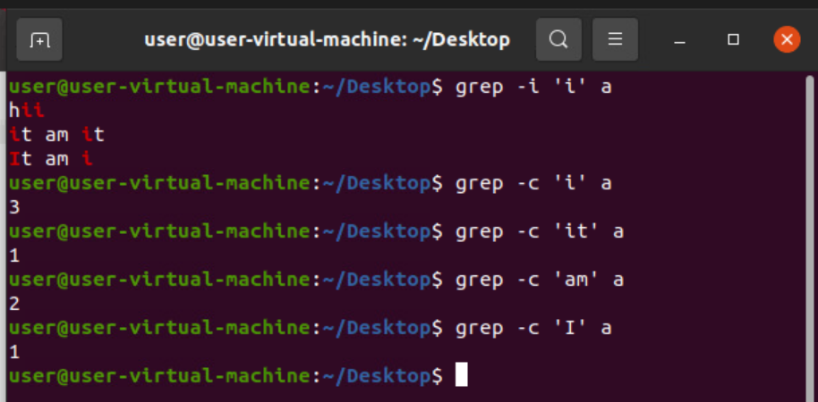
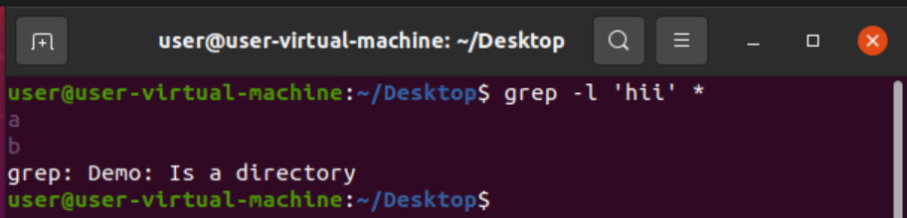
3) $grep –c 'word' filename :- Gives the count of word how many lines it present in file.
4) $ grep –l 'word' * :- used to find the files the word is present in.

Slide 3
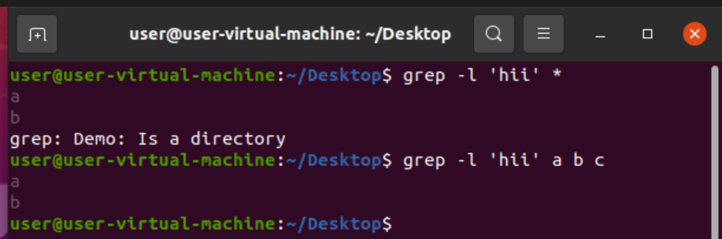
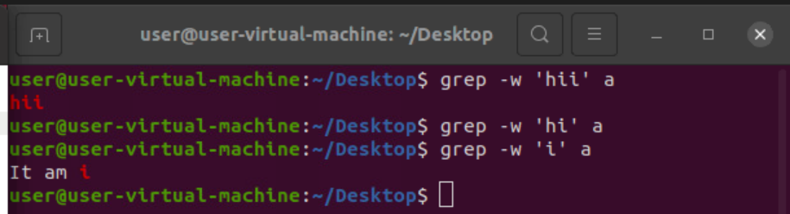
5) $ grep –l 'word' f1 f2 f3 :- It shows the file name which the word is present.
6) $ grep –w 'word' filename :- Used to show full fledged word in the file.

Slide 4
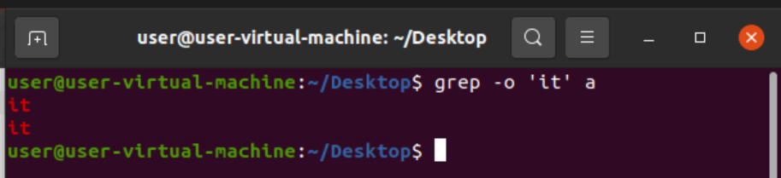
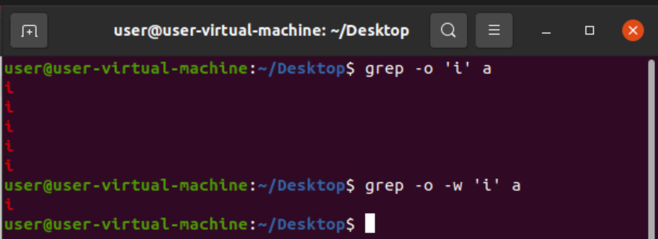
7) $ grep –o 'word' filename :- Displays only word how many times it present.
8) $ grep –0 –w 'word' filename :- Displays only exact word.

Slide 5
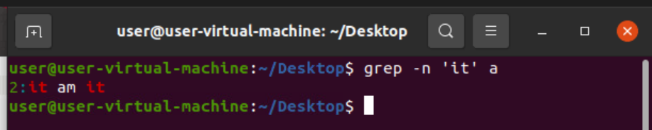
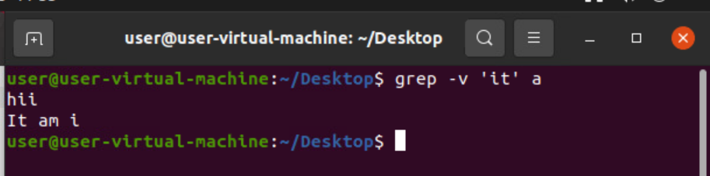
9) $ grep –n 'word' filename :- Shows the number of lines that the word is present.
10) $ grep –v 'word' filename :- It prints all the lines with the word is not present.

Slide 6
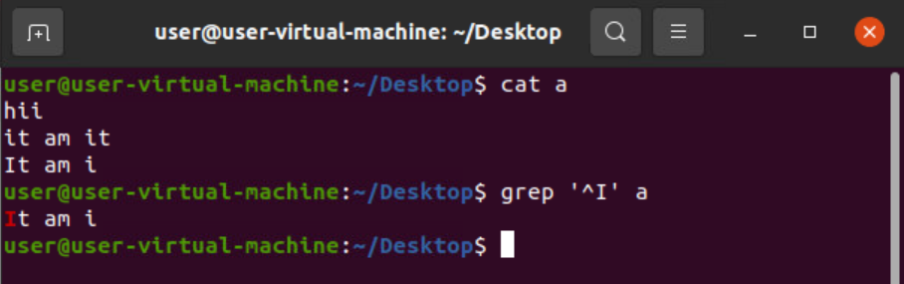
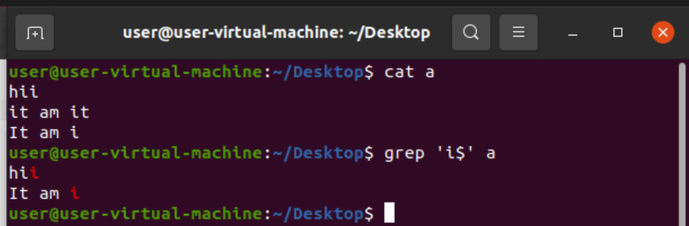
11) $ grep '^word' filename :- Shows the word starting with in the file name.
12) $ grep 'word$' filename :- Shows the data which are ending with word.

Slide 7
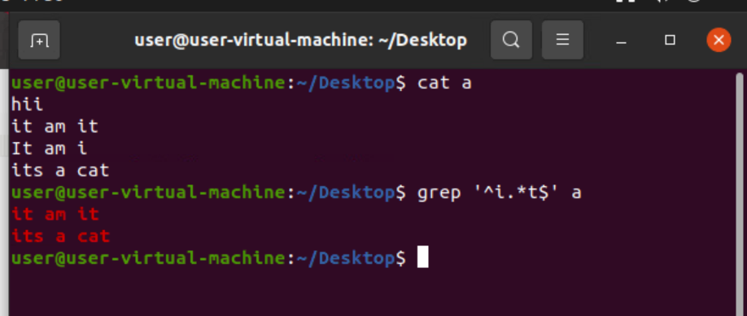
13) $ grep –nowl 'word' filename :- we can use all other commands at a time to get the required results.
14) $ grep –E '^Sword.*Eword$' filename :- It used to find the line start with and end with word.

Slide 8
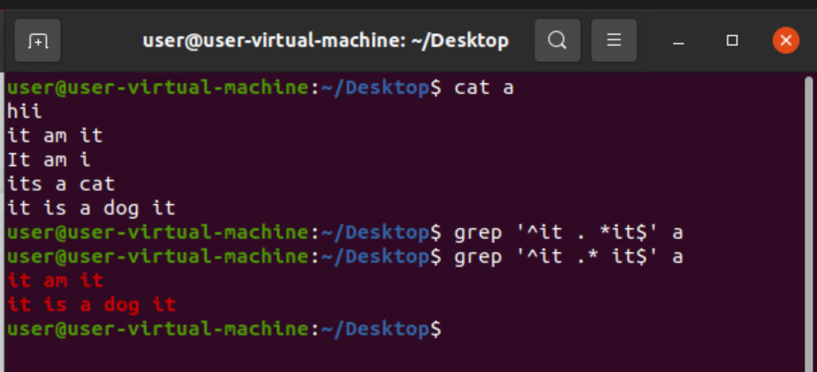
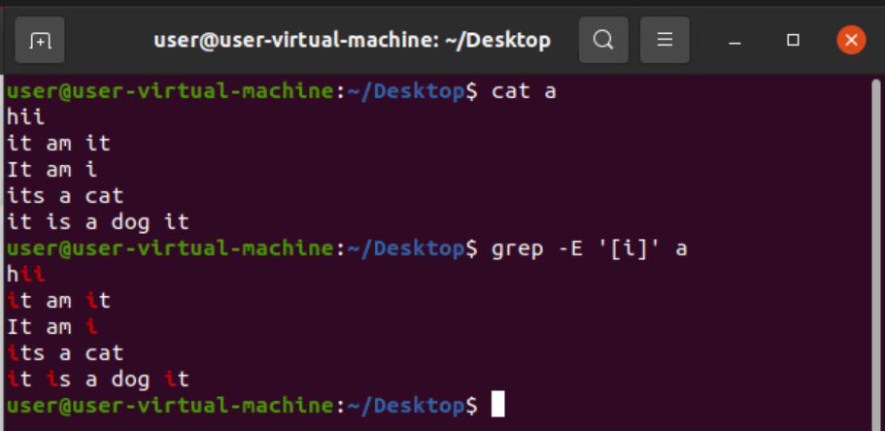
15) $ grep –E '^word .* word$' filename :- Gives the exact line starts with and end with.
16)$ grep –E '[char]' filename :- shows all the lines which char is present in the file.

Slide 9
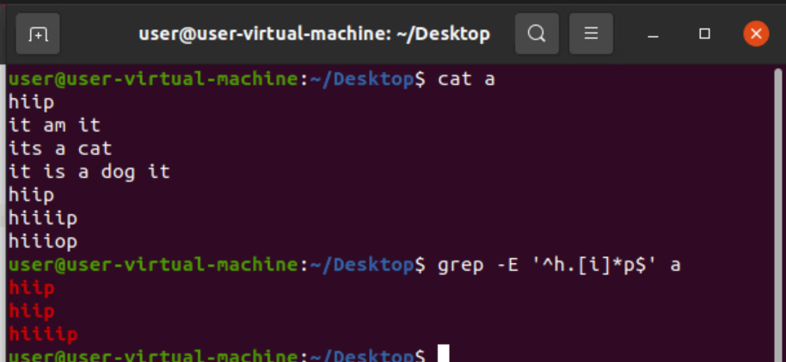
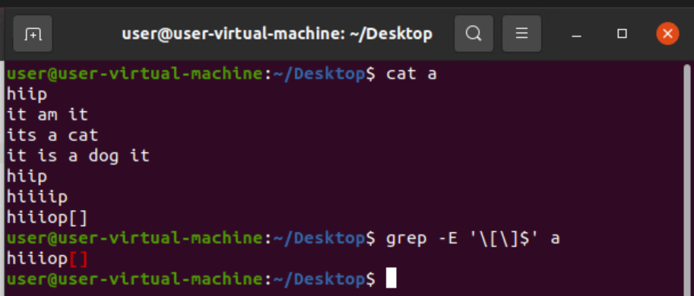
17) $ grep –E '^sw.[char]*ew$' filename :- This command shows the lines which are present in between start word and endword and occurence of a character.
18) $ grep –E '\[\]$' filename :- This command is used to check which line is ending with [].

Slide 10
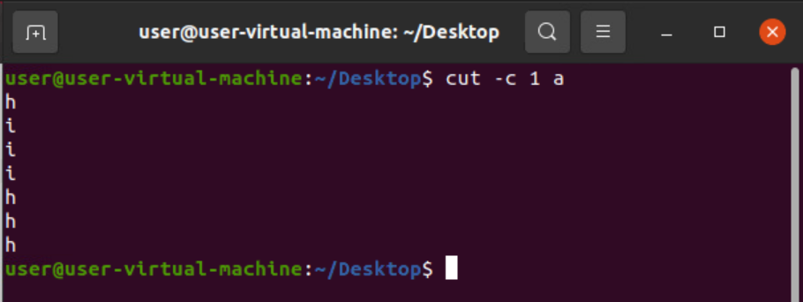
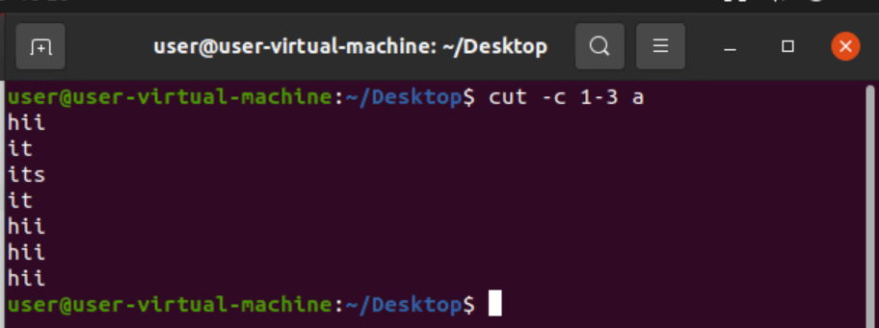
19)cut –c 1 filename : Used to show the first character in every line.
20) cut –c 1-4 filename :- Used to show range of characters in every line.

Slide 11
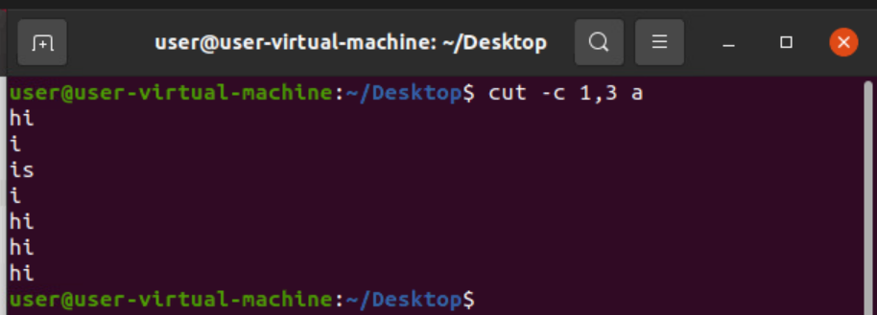
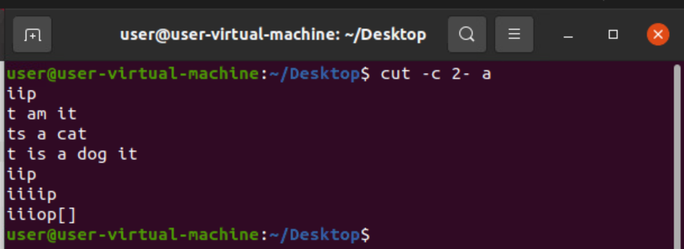
21) cut –c 1,4 fn :- Used to show only given position of char in every file.
22) cut –c 2- fn :- Gives the required coloumn to the last column in the lines.

Slide 12
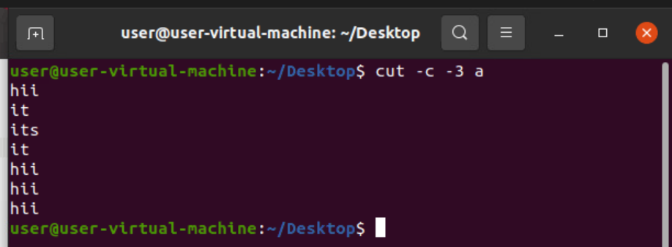
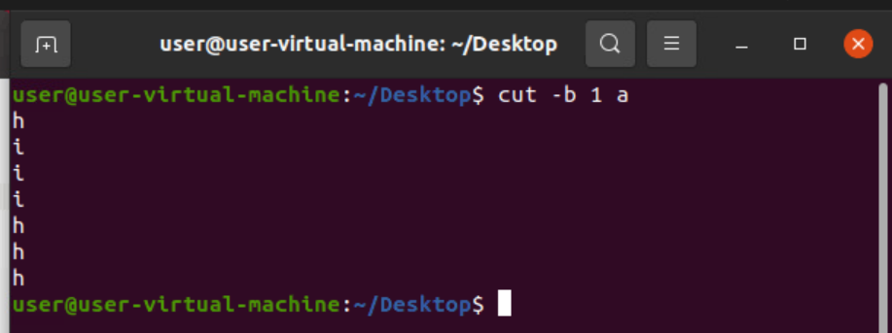
23) cut –c –3 fn :- It gives the characters from starting to required number.
24) cut –b 1 fn :- Its same as c command but it search based on bytes.

Slide 13
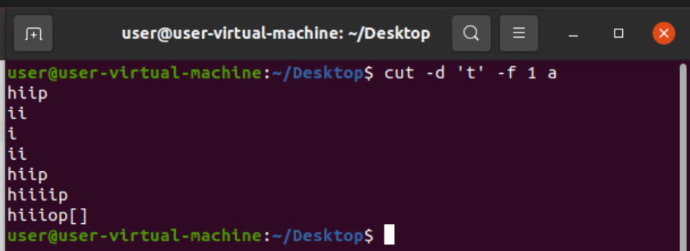
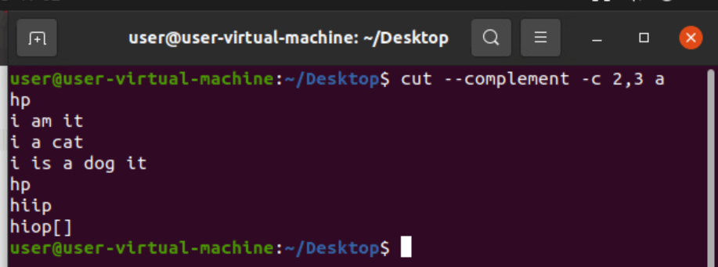
25)cut –d 'char ' -f 1 fn :- Used to remove the characters after char occurrence.
26) cut - - complement -c 1,5 fn :- It eliminates the char in between the range and displays.
Note : Compliment is used for doing reverse of c,b and d comands.

Slide 14
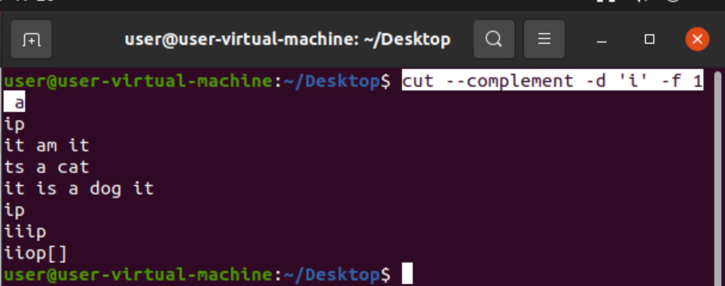
27) cut – compliment –d 'i' -f 1 a : removes the all characters before of char and displays left data.
28) | -> it’s a pipe command used to combine two or more commands.

Slide 15
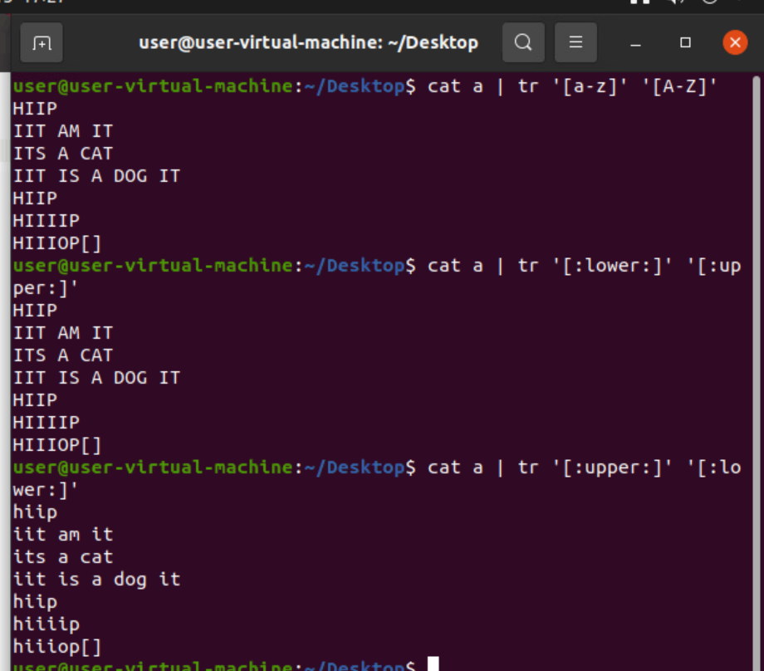
29) cat fn | tr '[a-z]' '[A-Z]'
| tr '[:lower:]' '[:upper:]' :-- this command is used to change the characters from lower to upper and vice versa.

Slide 16
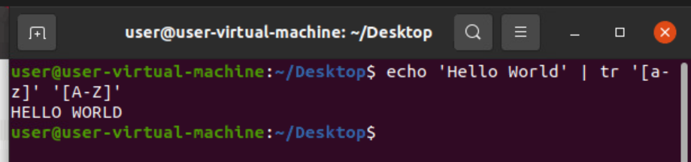
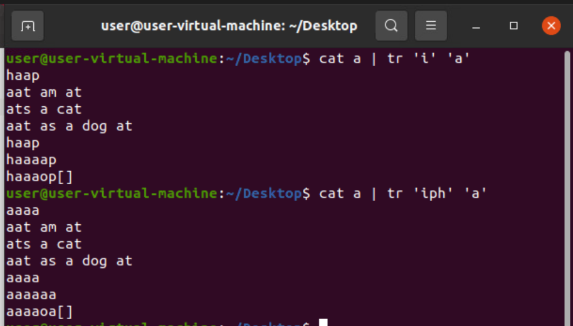
30) echo 'Hello World' | tr '[a-z]' '[A-Z]' :-- Used to change the all lower case to upper case.
31) cat fn | tr 'i' 'r' :-It changes i char to r char in file.
32) cat fn | tr 'ilk' 'r' :- It changes I,l,k to r char in file.

Slide 17
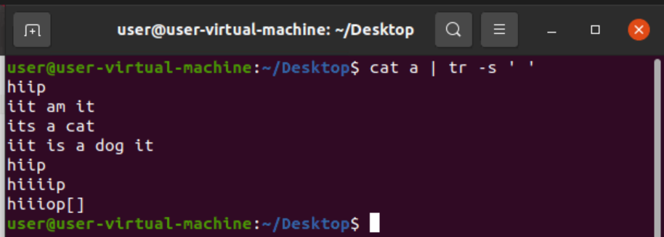
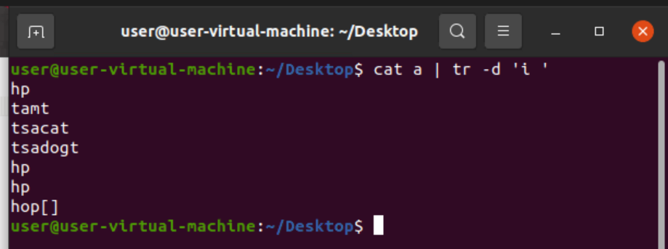
33) cat fn | tr –s ' ' :- It removes extra spaces and gives only one space.
34) cat fn | tr –d 'i' :- for deleting char(i) we use this command.
35) cat fn | tr –d 'ik' :- for deleting char(I,k) we use this command.

Slide 18
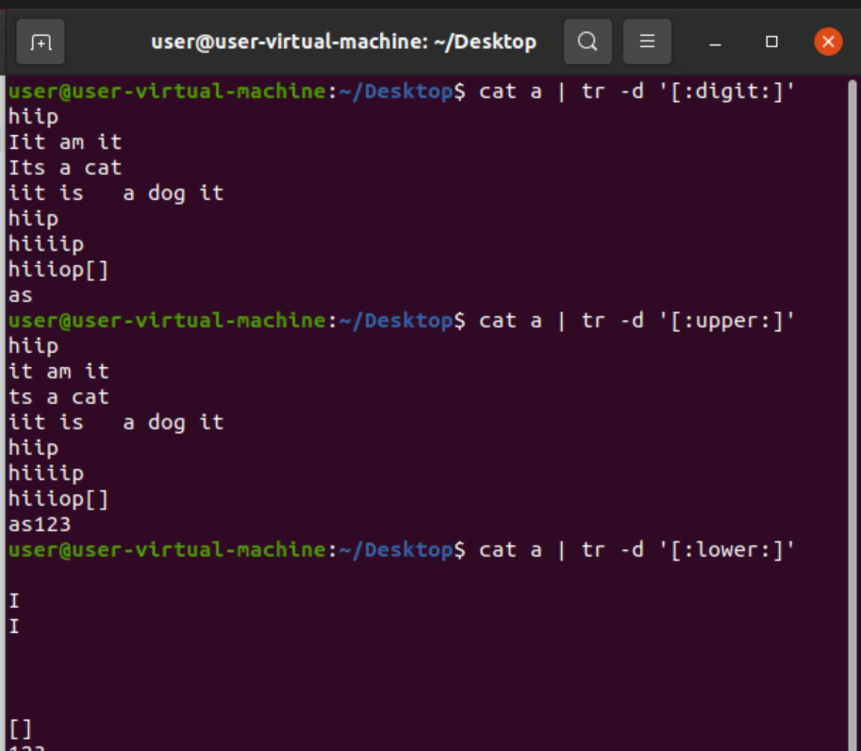
36) cat fn | tr –d '[:digit:]' :- used to delete all the digits present in file.
37) cat fn | tr –d '[:upper:]' :- used to delete all upper case characters and vice versa for lower.
38) cat fn | tr –d '[A-Z]' (or) '[a-z]' :- it deletes all char in between them.

Slide 19
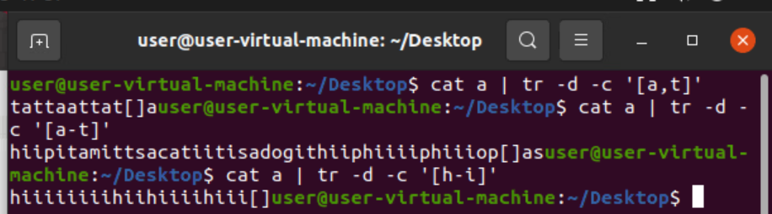
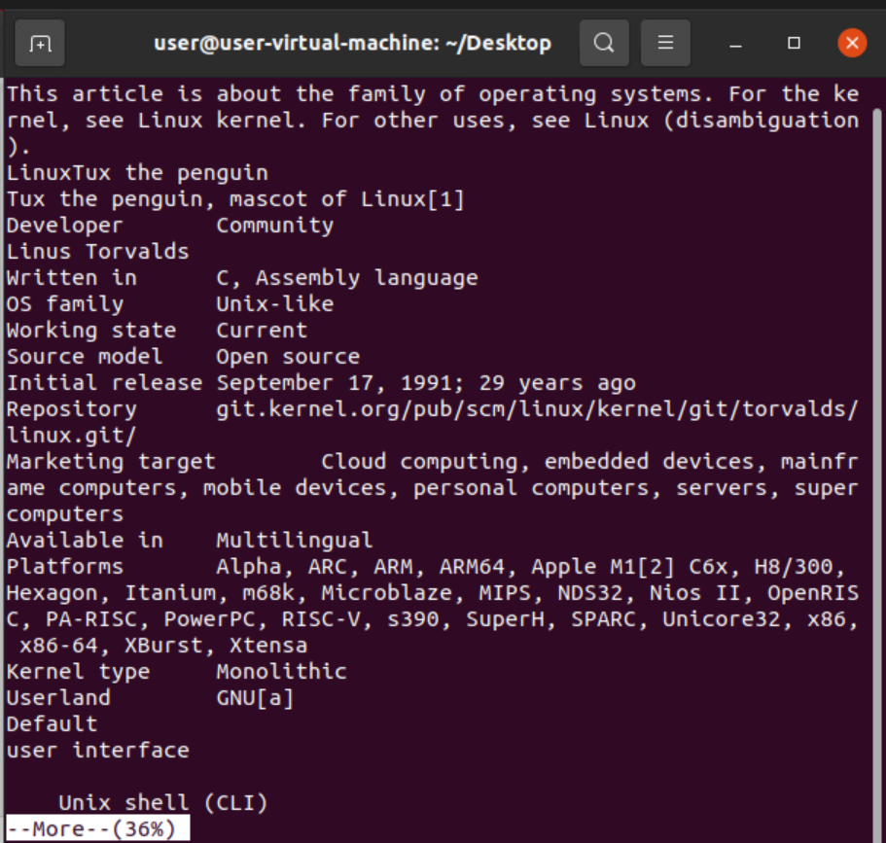
39)cat a | tr –d –c '[a-t]' :-- removes everything in between a and t.
40) $ more fn :- used to see long data in page by page. b for previous page enter for next line and space for next page.

Slide 20
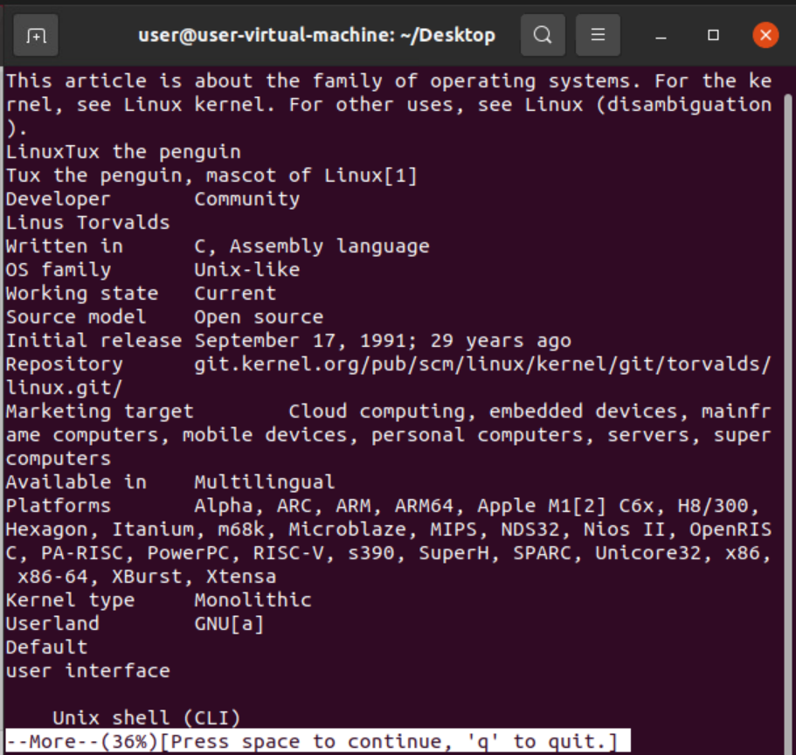
41) more –d fn :- used to show the data with some help shortcuts.

Slide 21
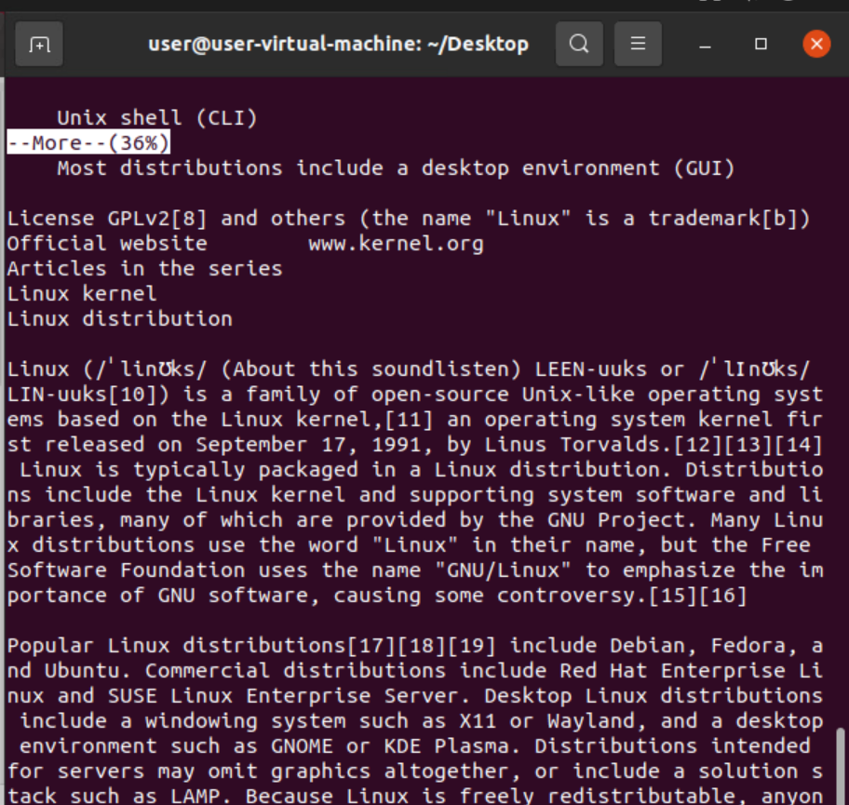
42) more –p file : It shows % of files by page by page.
43) more –s file : Used to remove extra spaces.

